Slide 1
Do You Know Anyone Who Needs an ESC?
ESC—Emotional Support Chicken

Slide 2
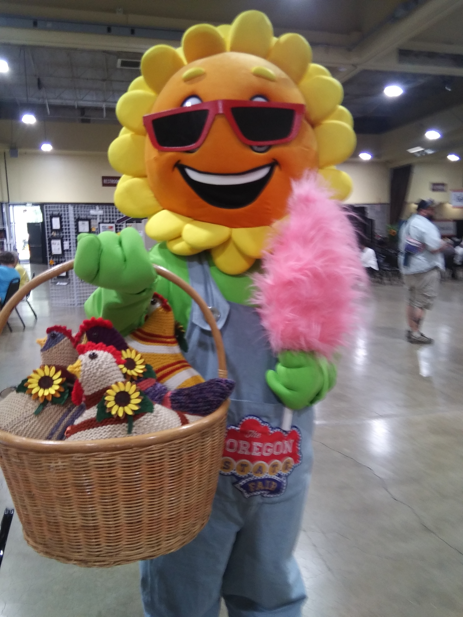
Our Group Does and Responded
They were a hit at the Oregon State Fair with everyone that came by.
We could have sold a hundred of them!

Slide 3
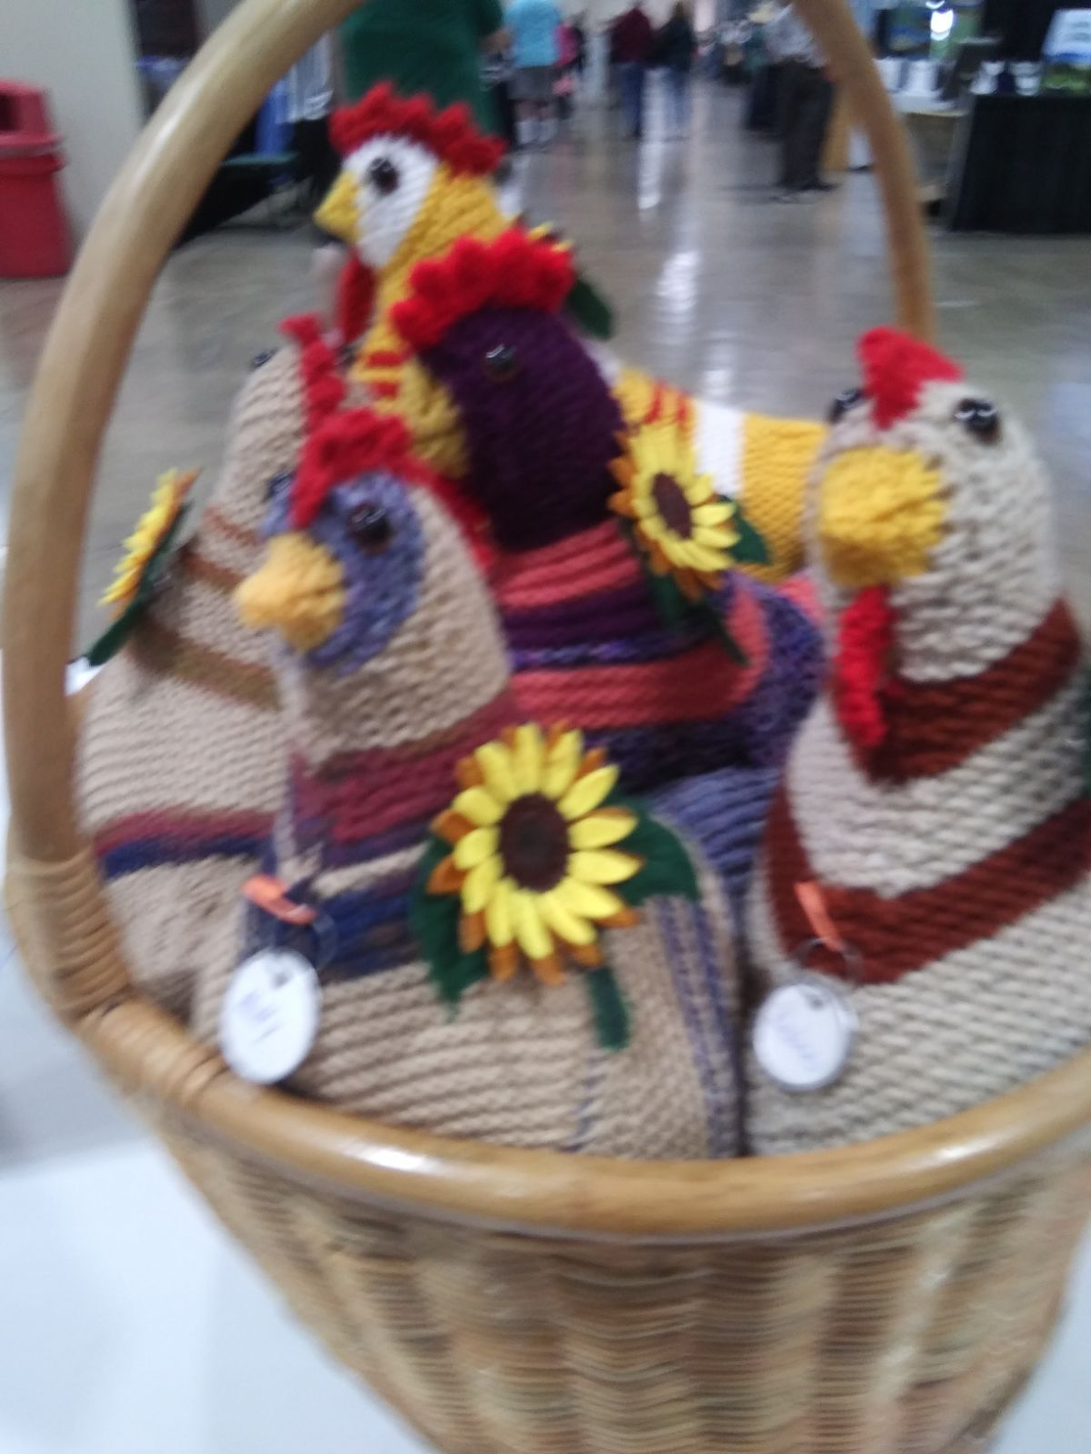

Slide 4
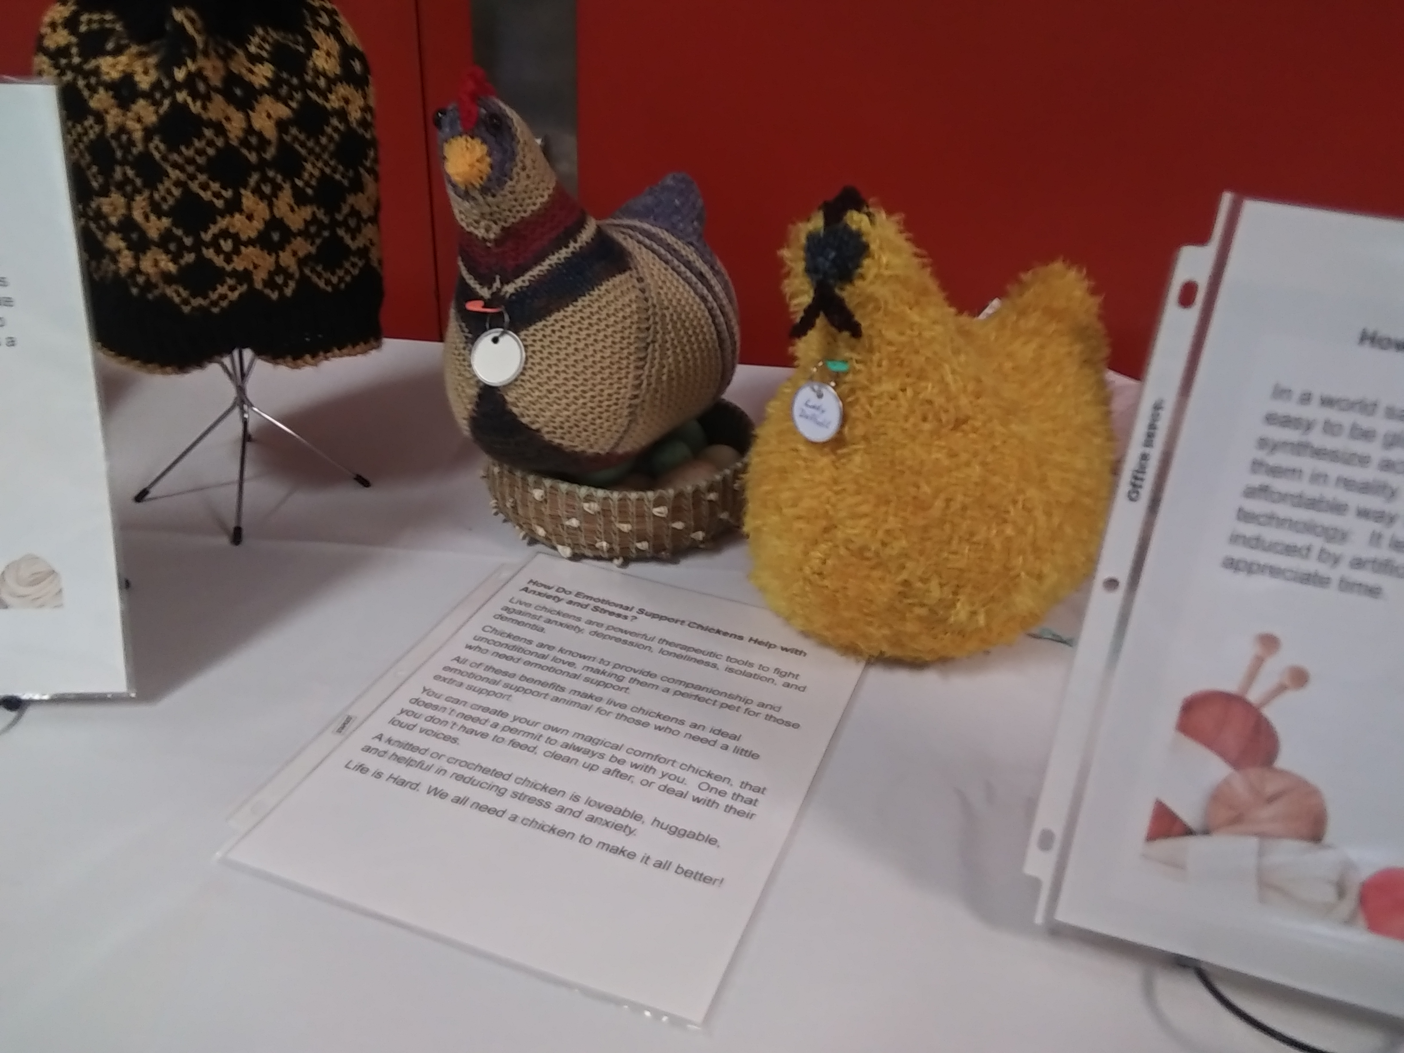
At CCC
Wellness Event

Slide 5
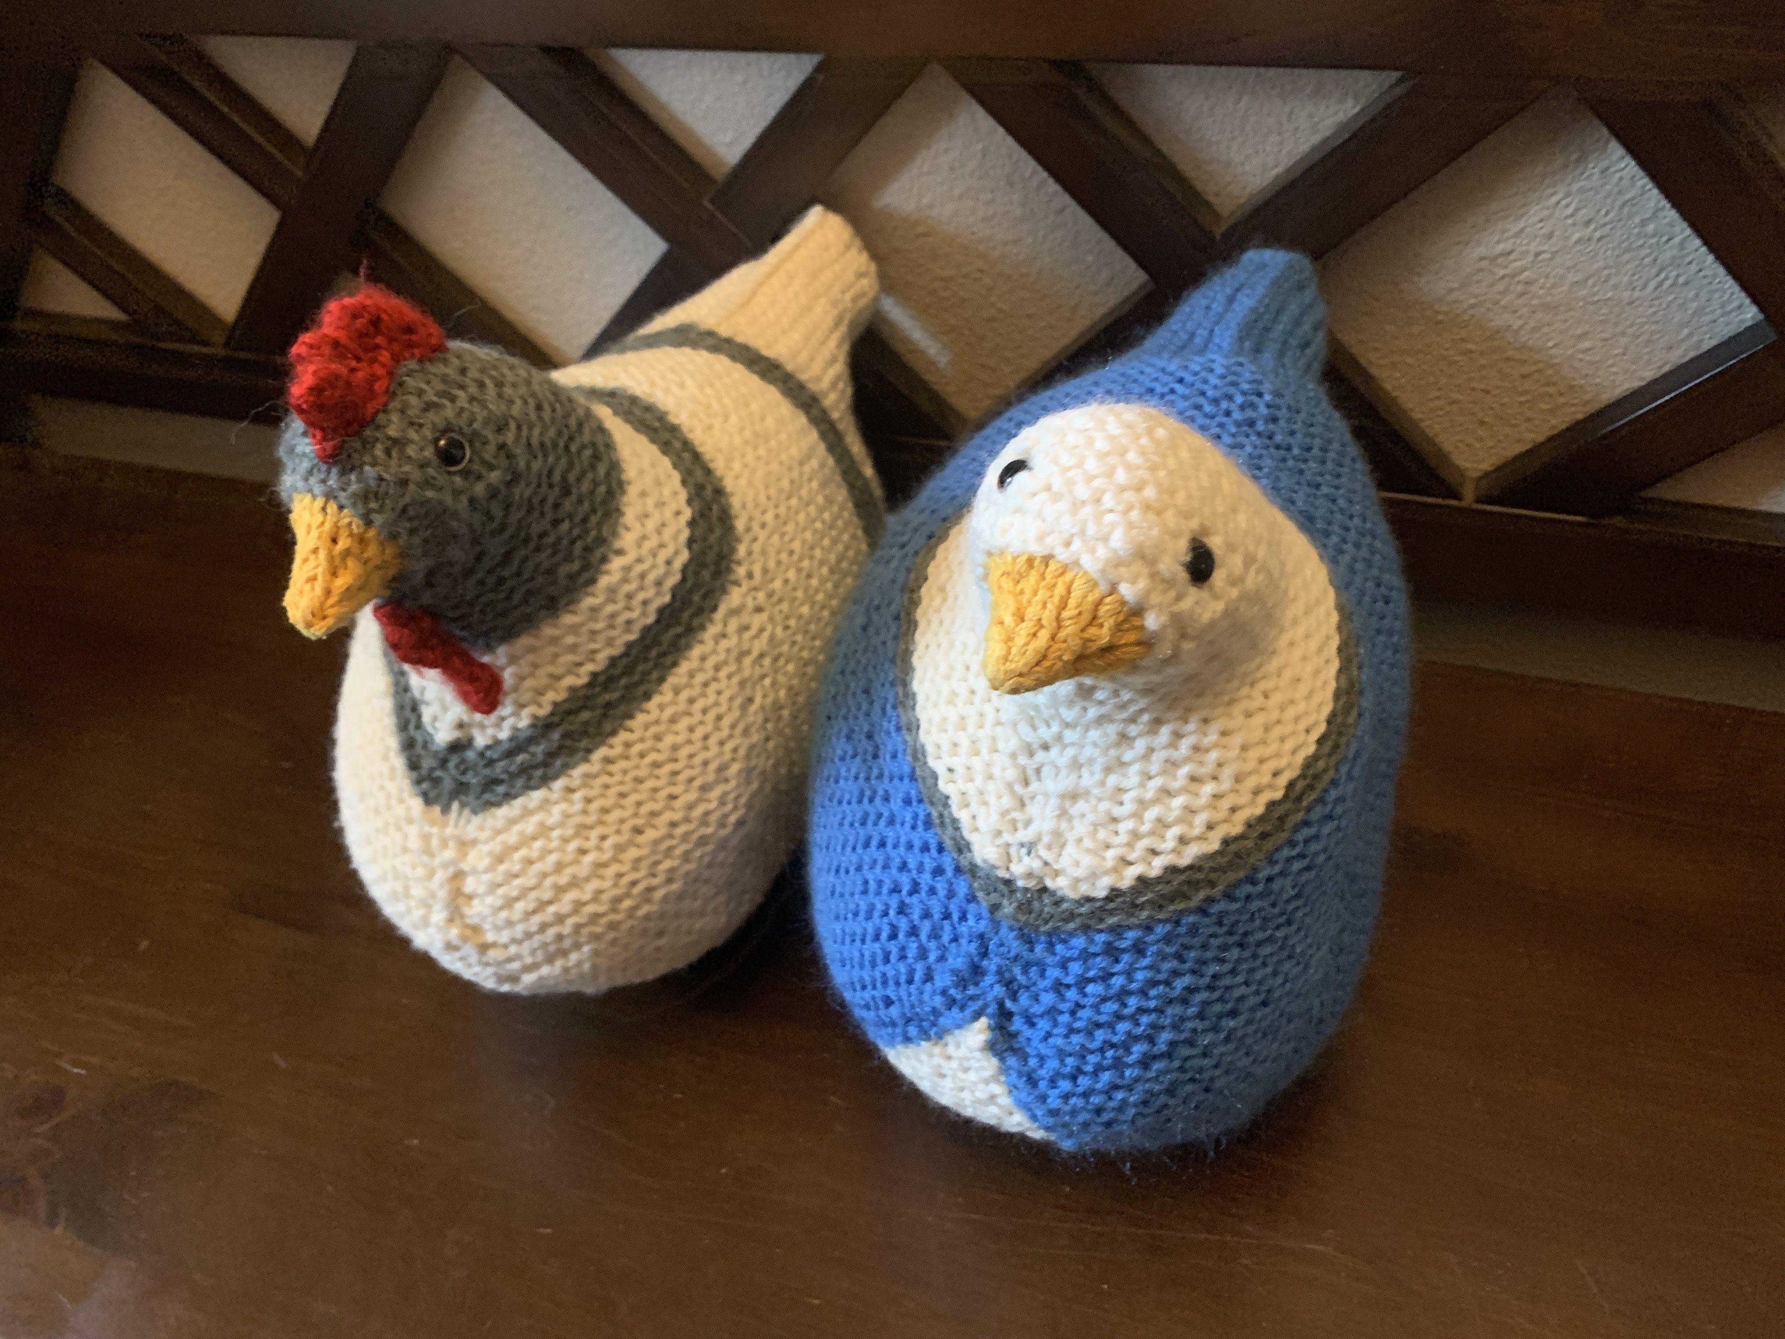
Heather

Slide 6
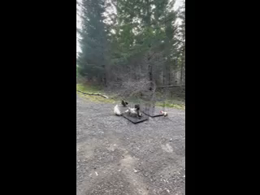
Debbie

Slide 7
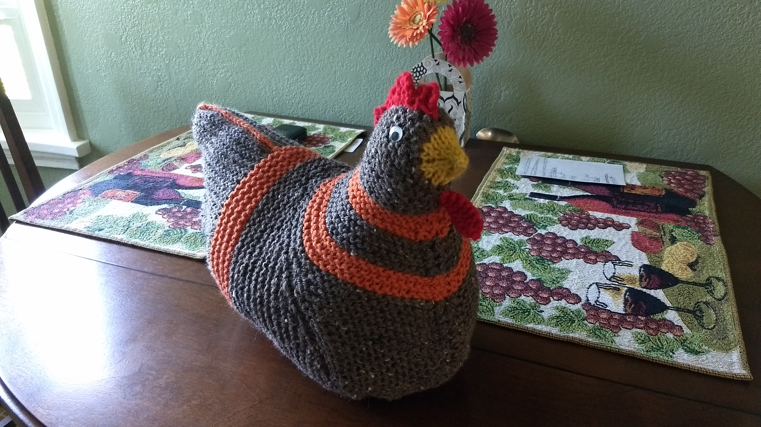
Debbie

Slide 8
Diane

Slide 9
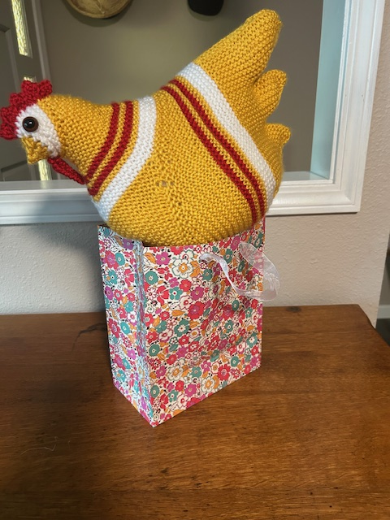
Diane

Slide 10
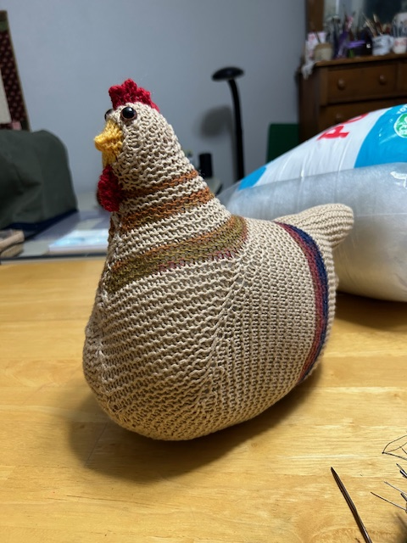
Diane

Slide 11
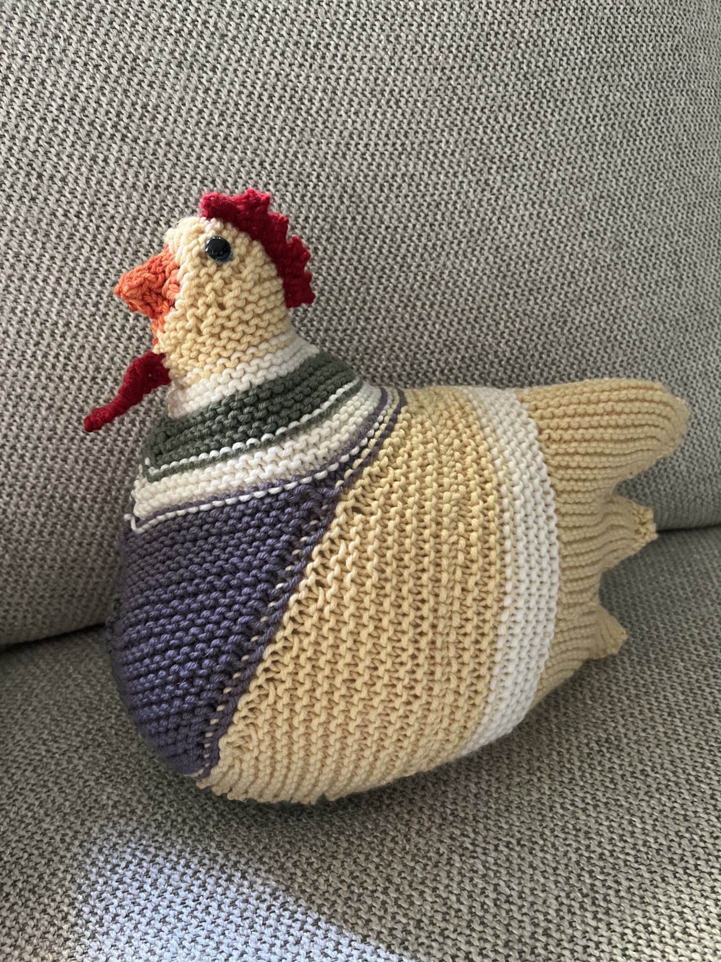
Judith

Slide 12
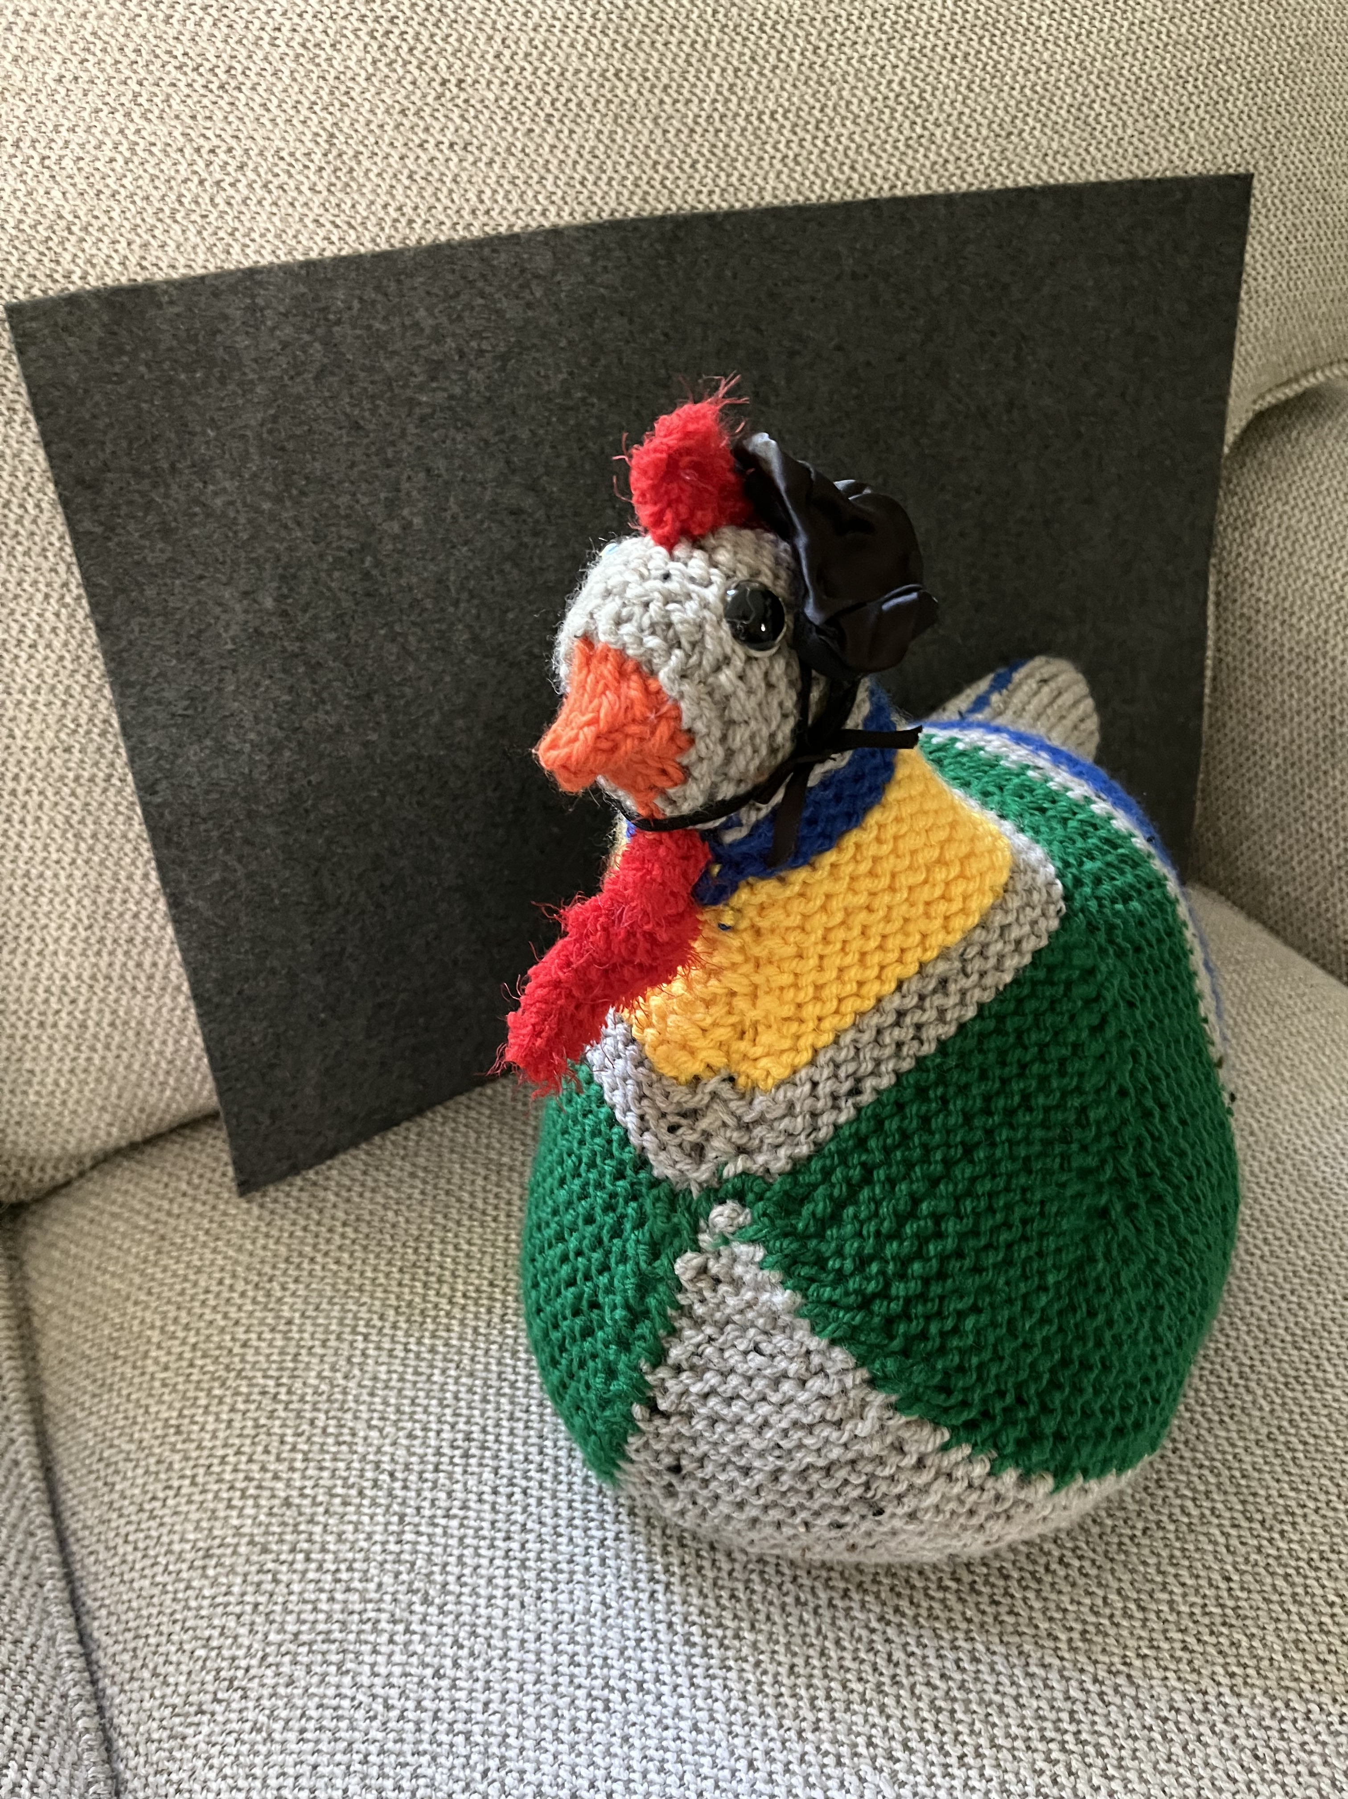
Judith

Slide 13
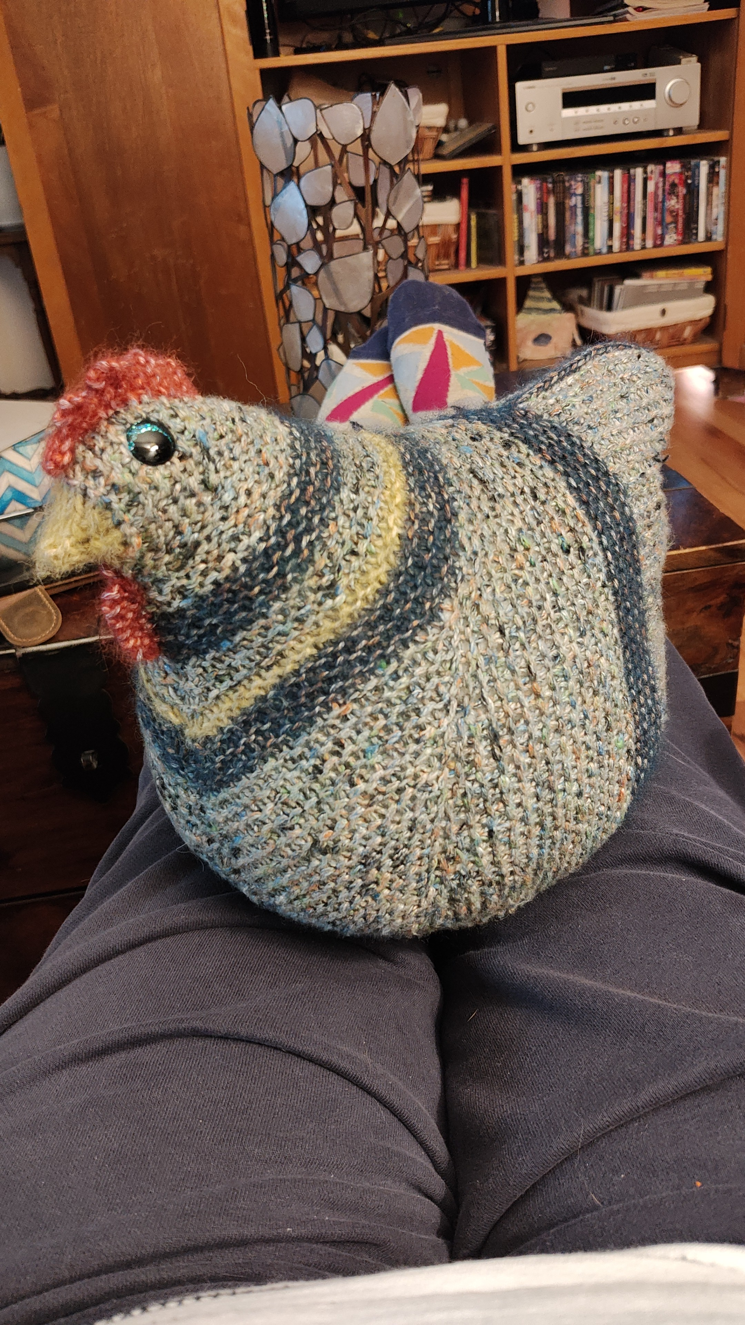
  Michelle S

Slide 14
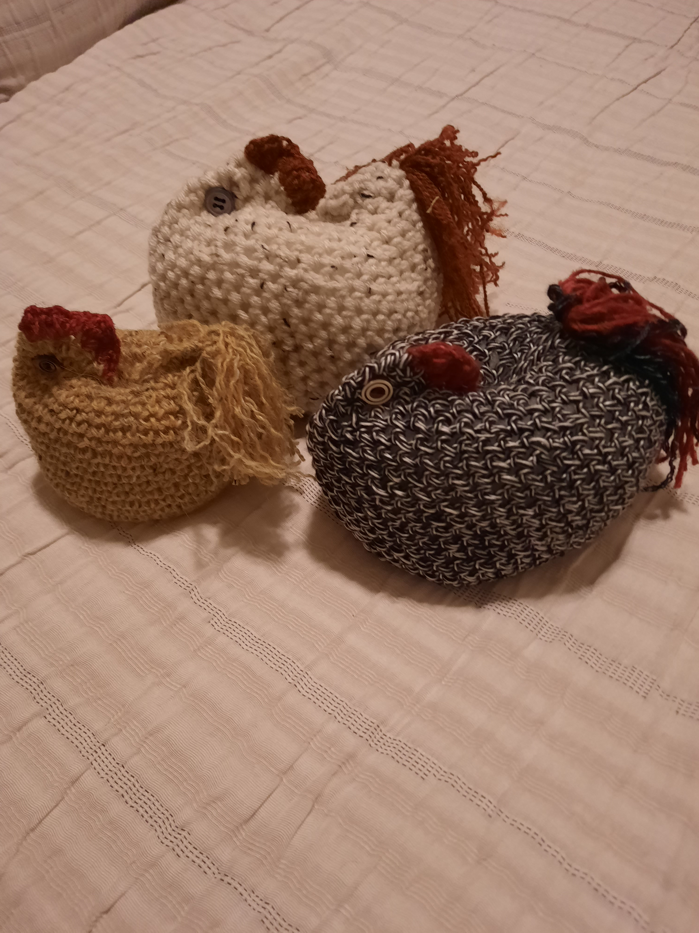
Marion
Crocheted ESC

Slide 15
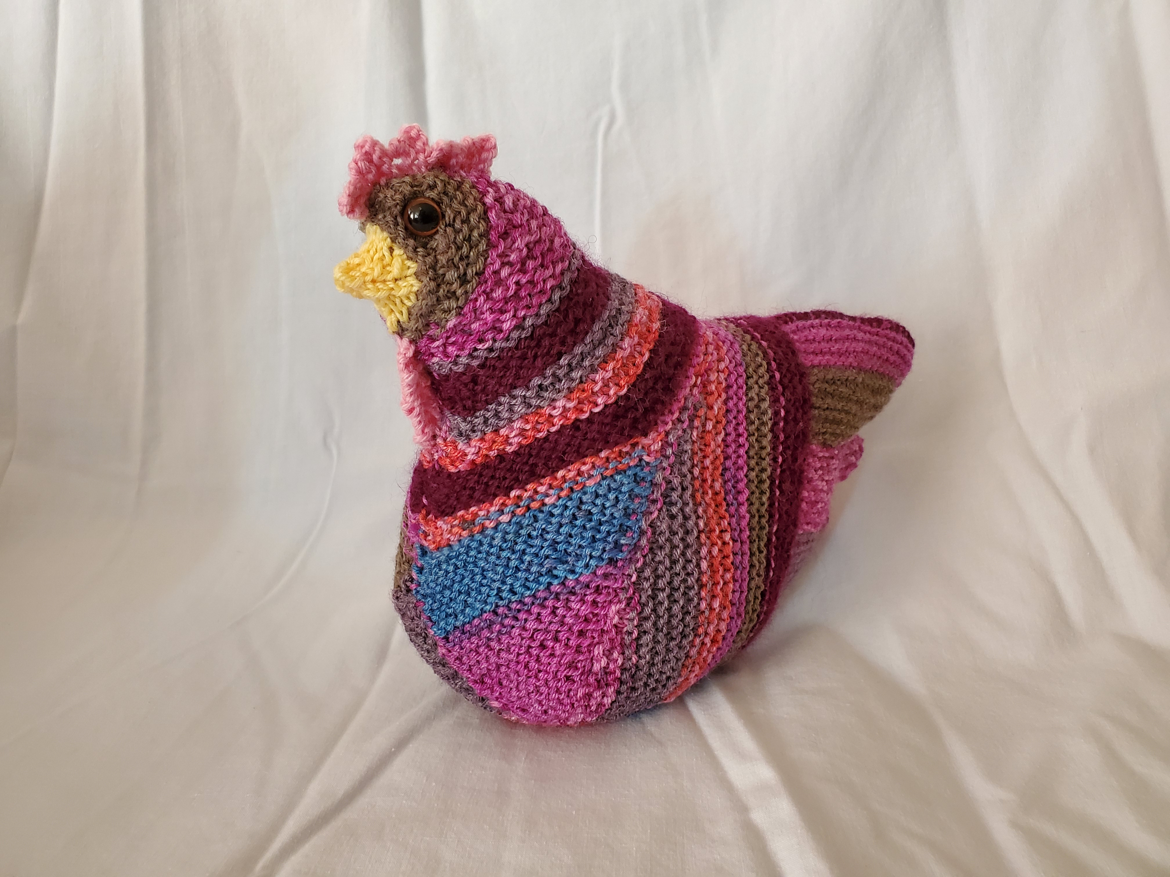
Marsha

Slide 16
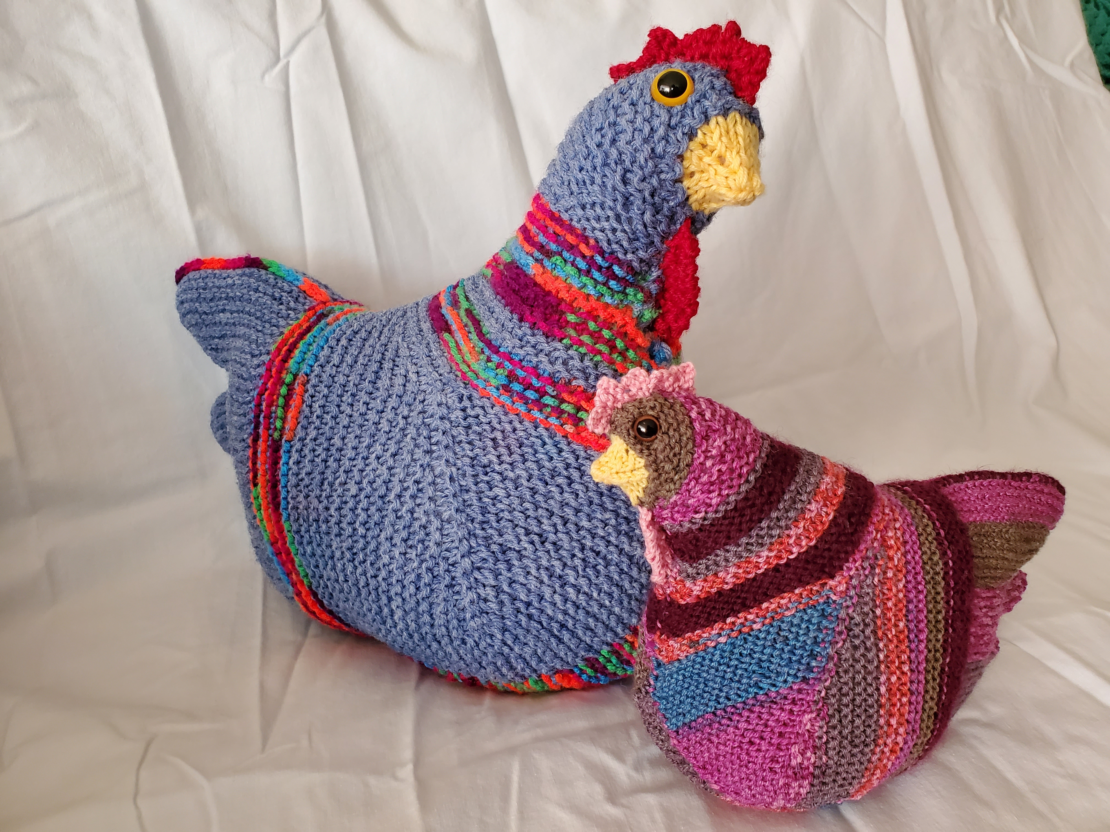
Marsha

Slide 17
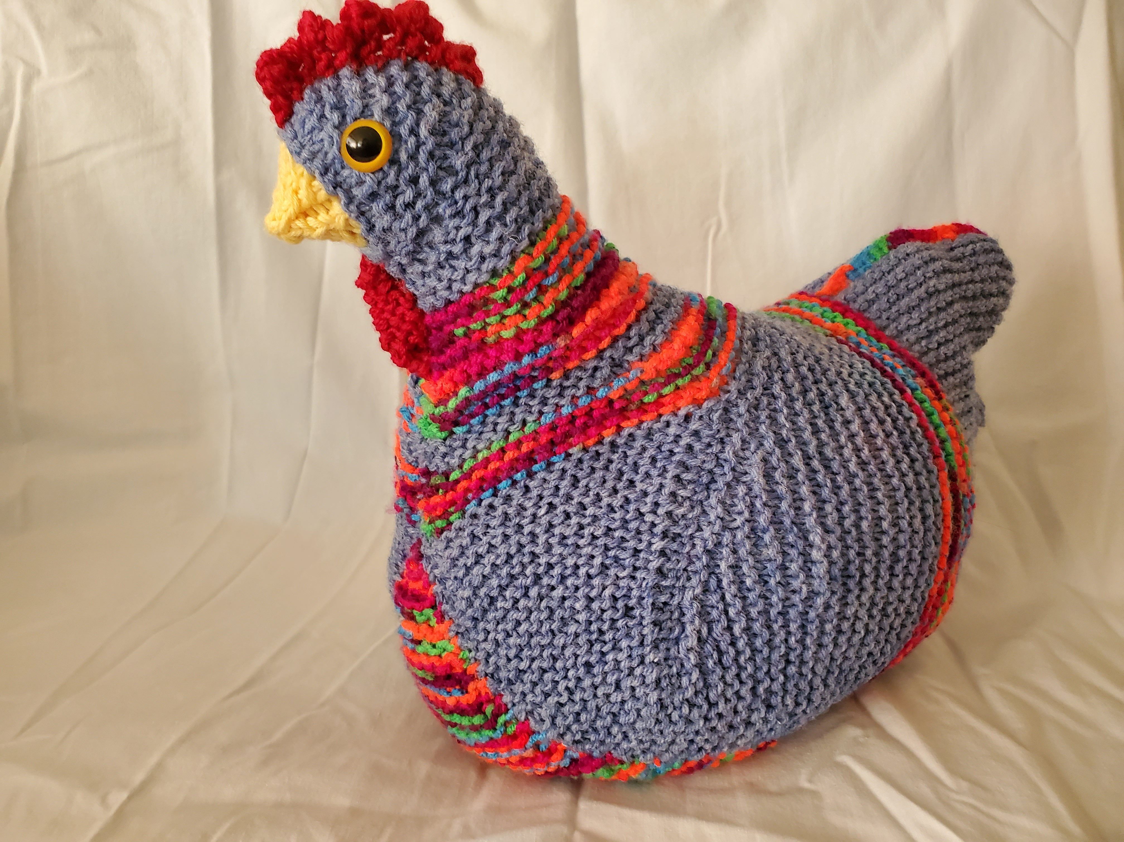
Marsha

Slide 18
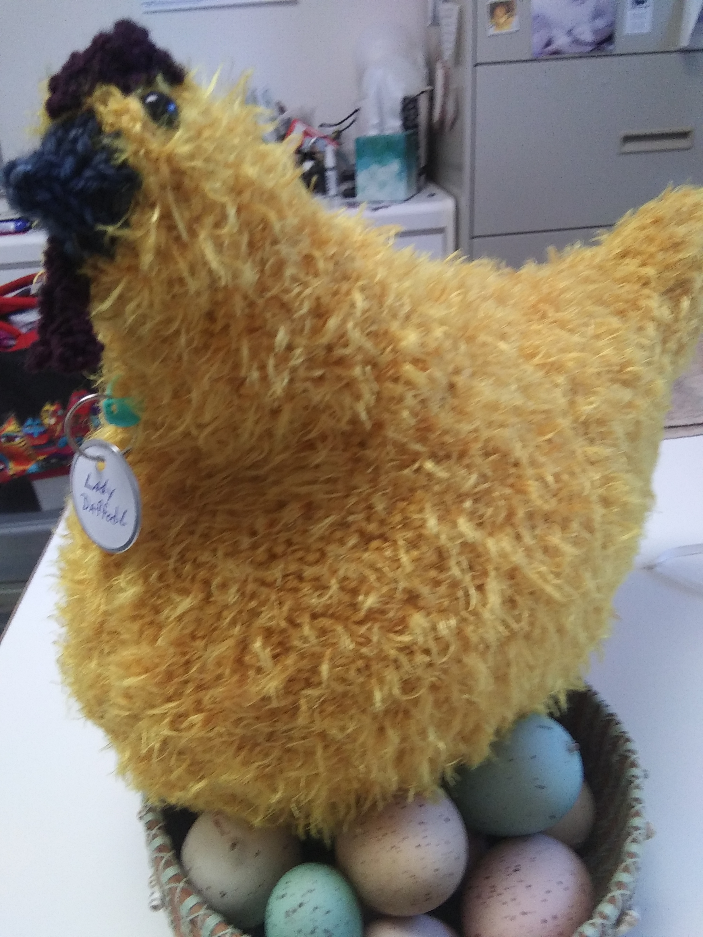
Su

Slide 19
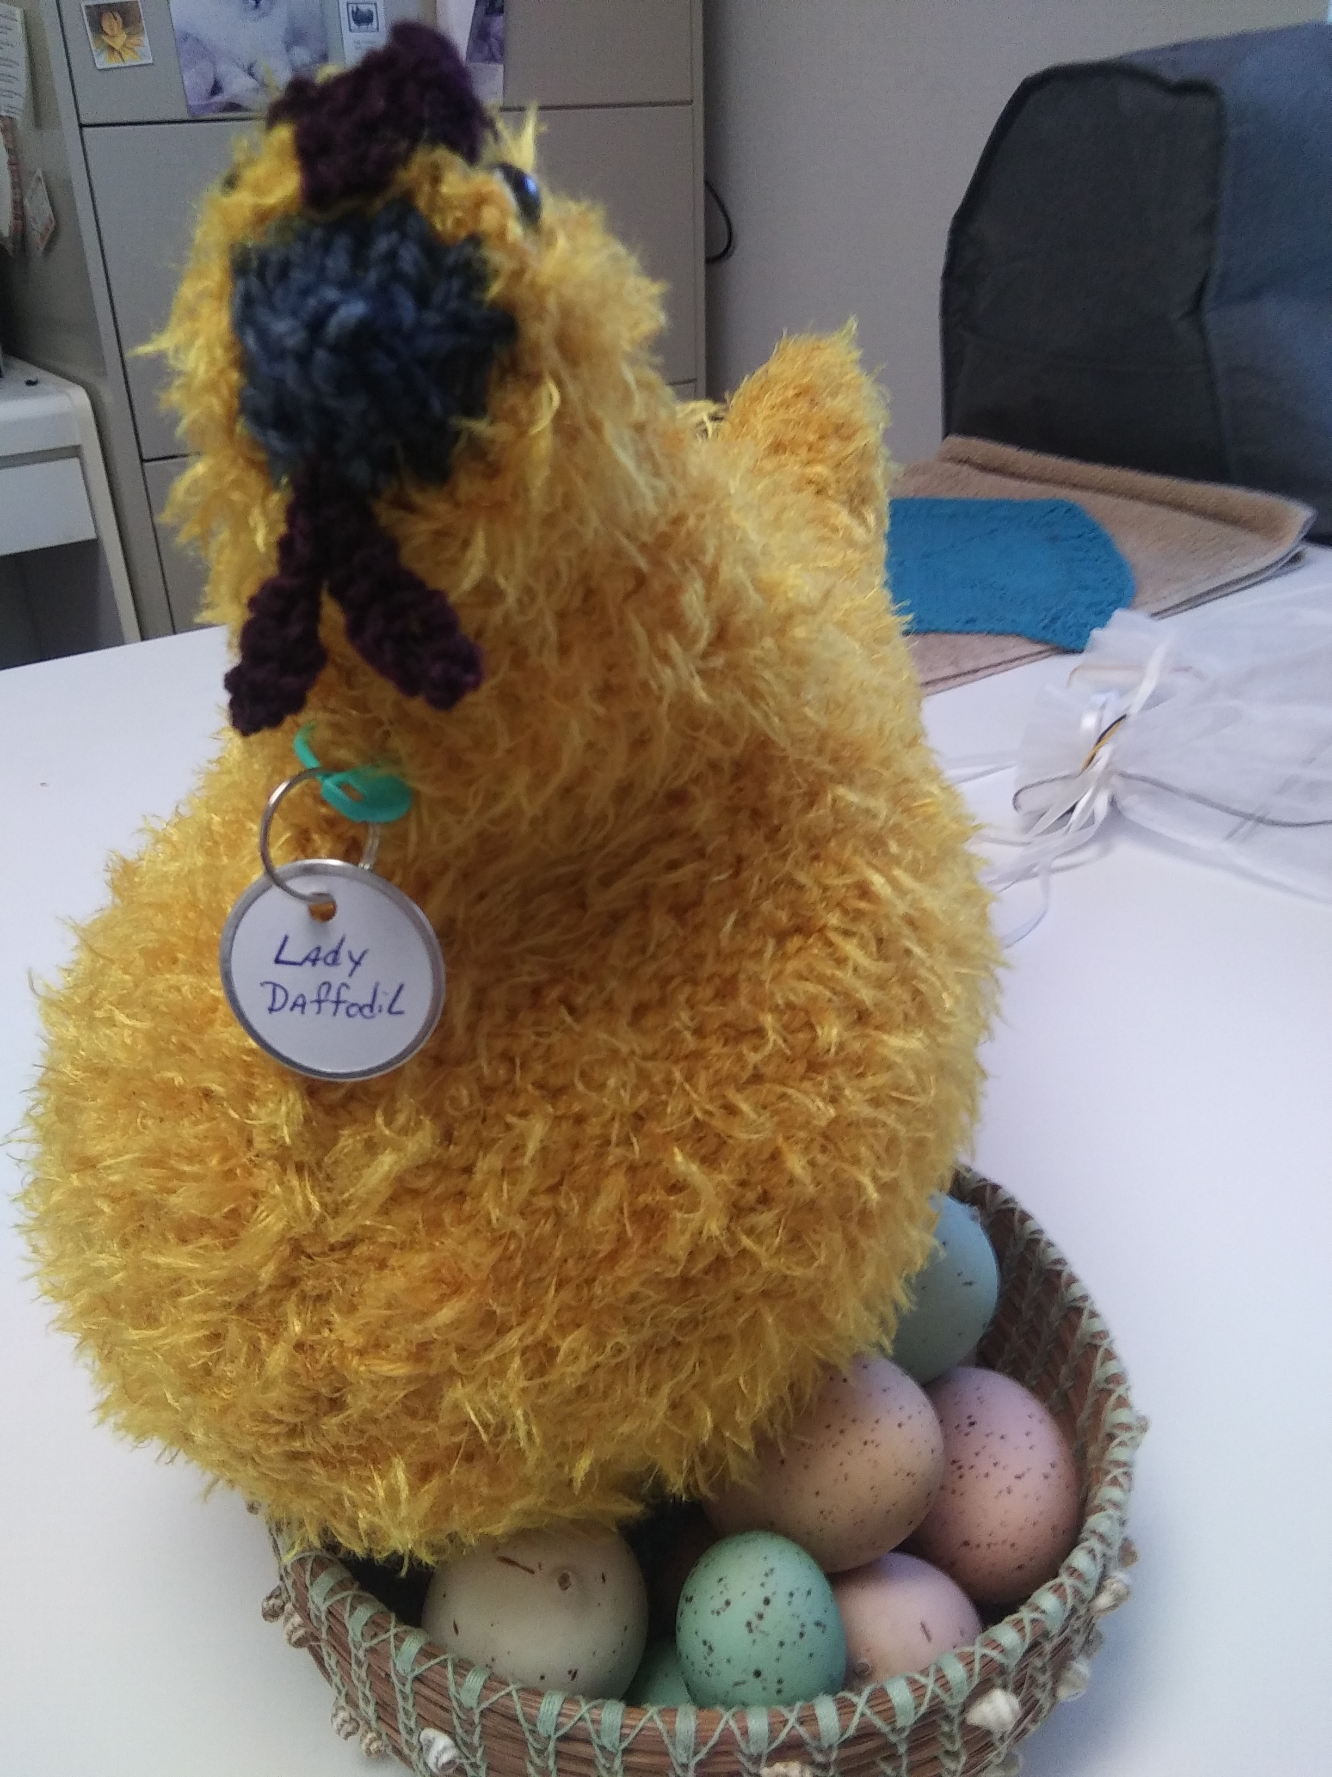
Su

Slide 20
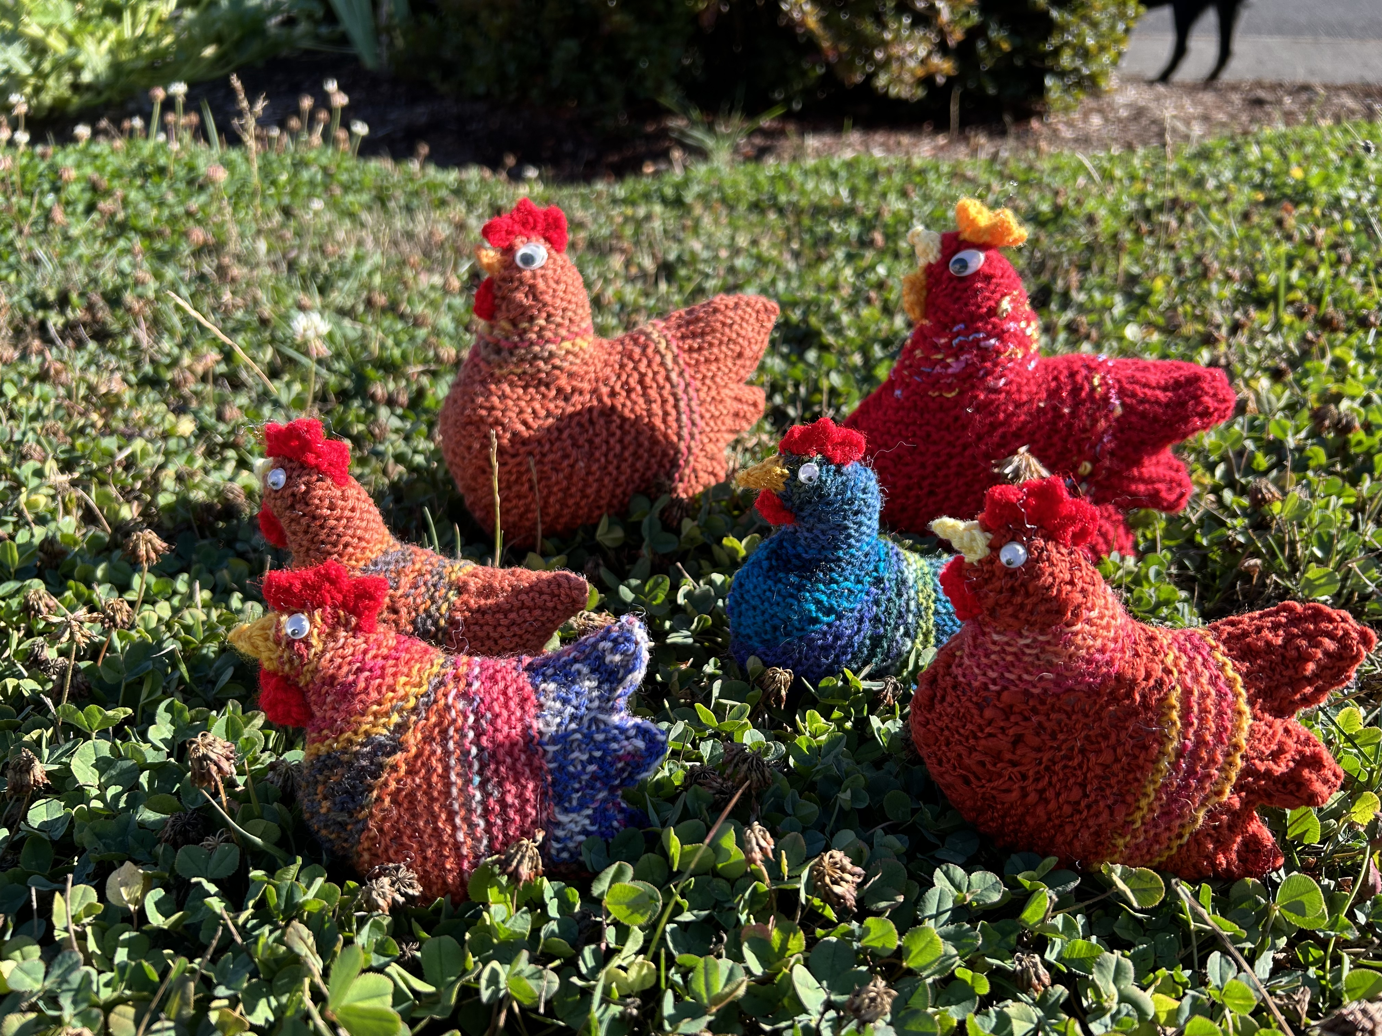
Sara

Slide 21
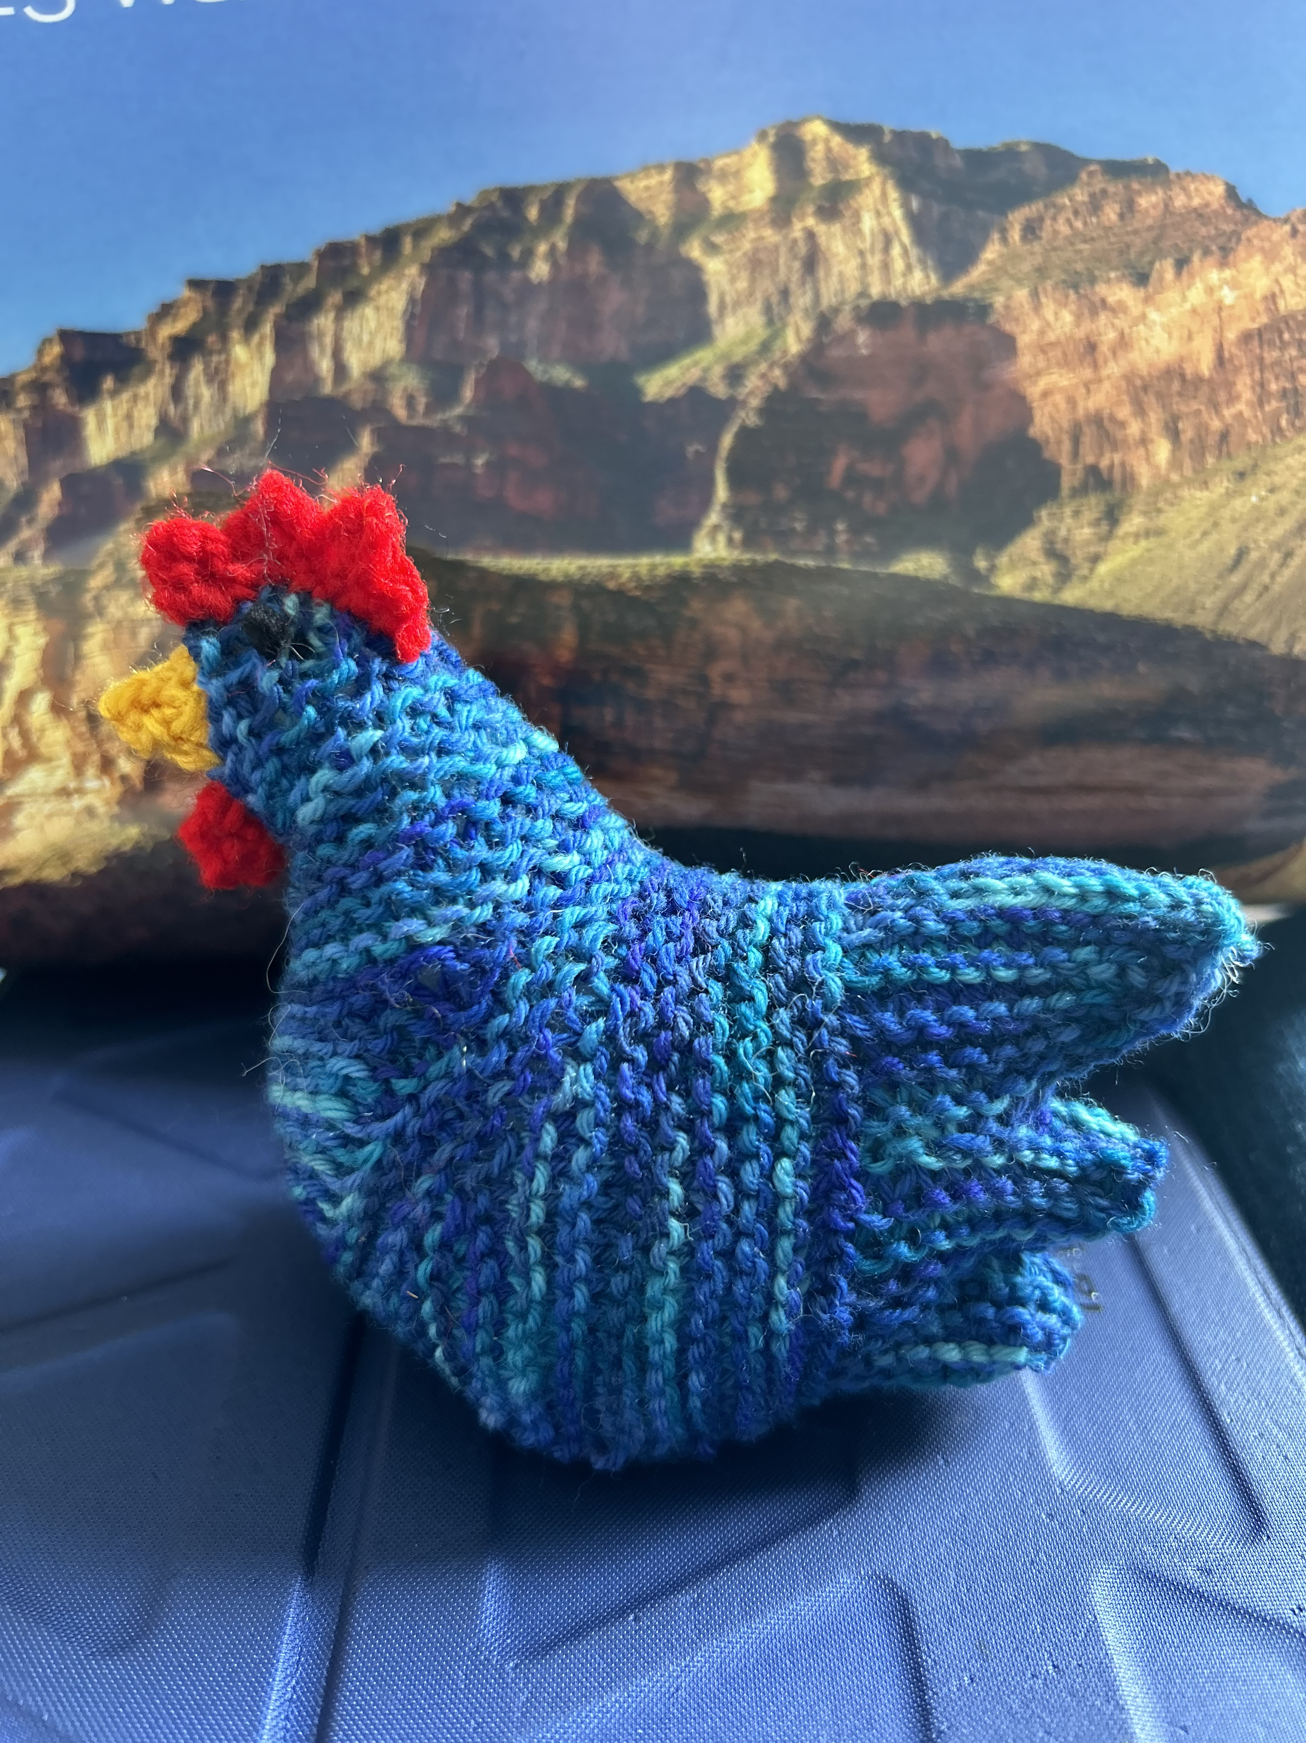
Sara

Slide 22
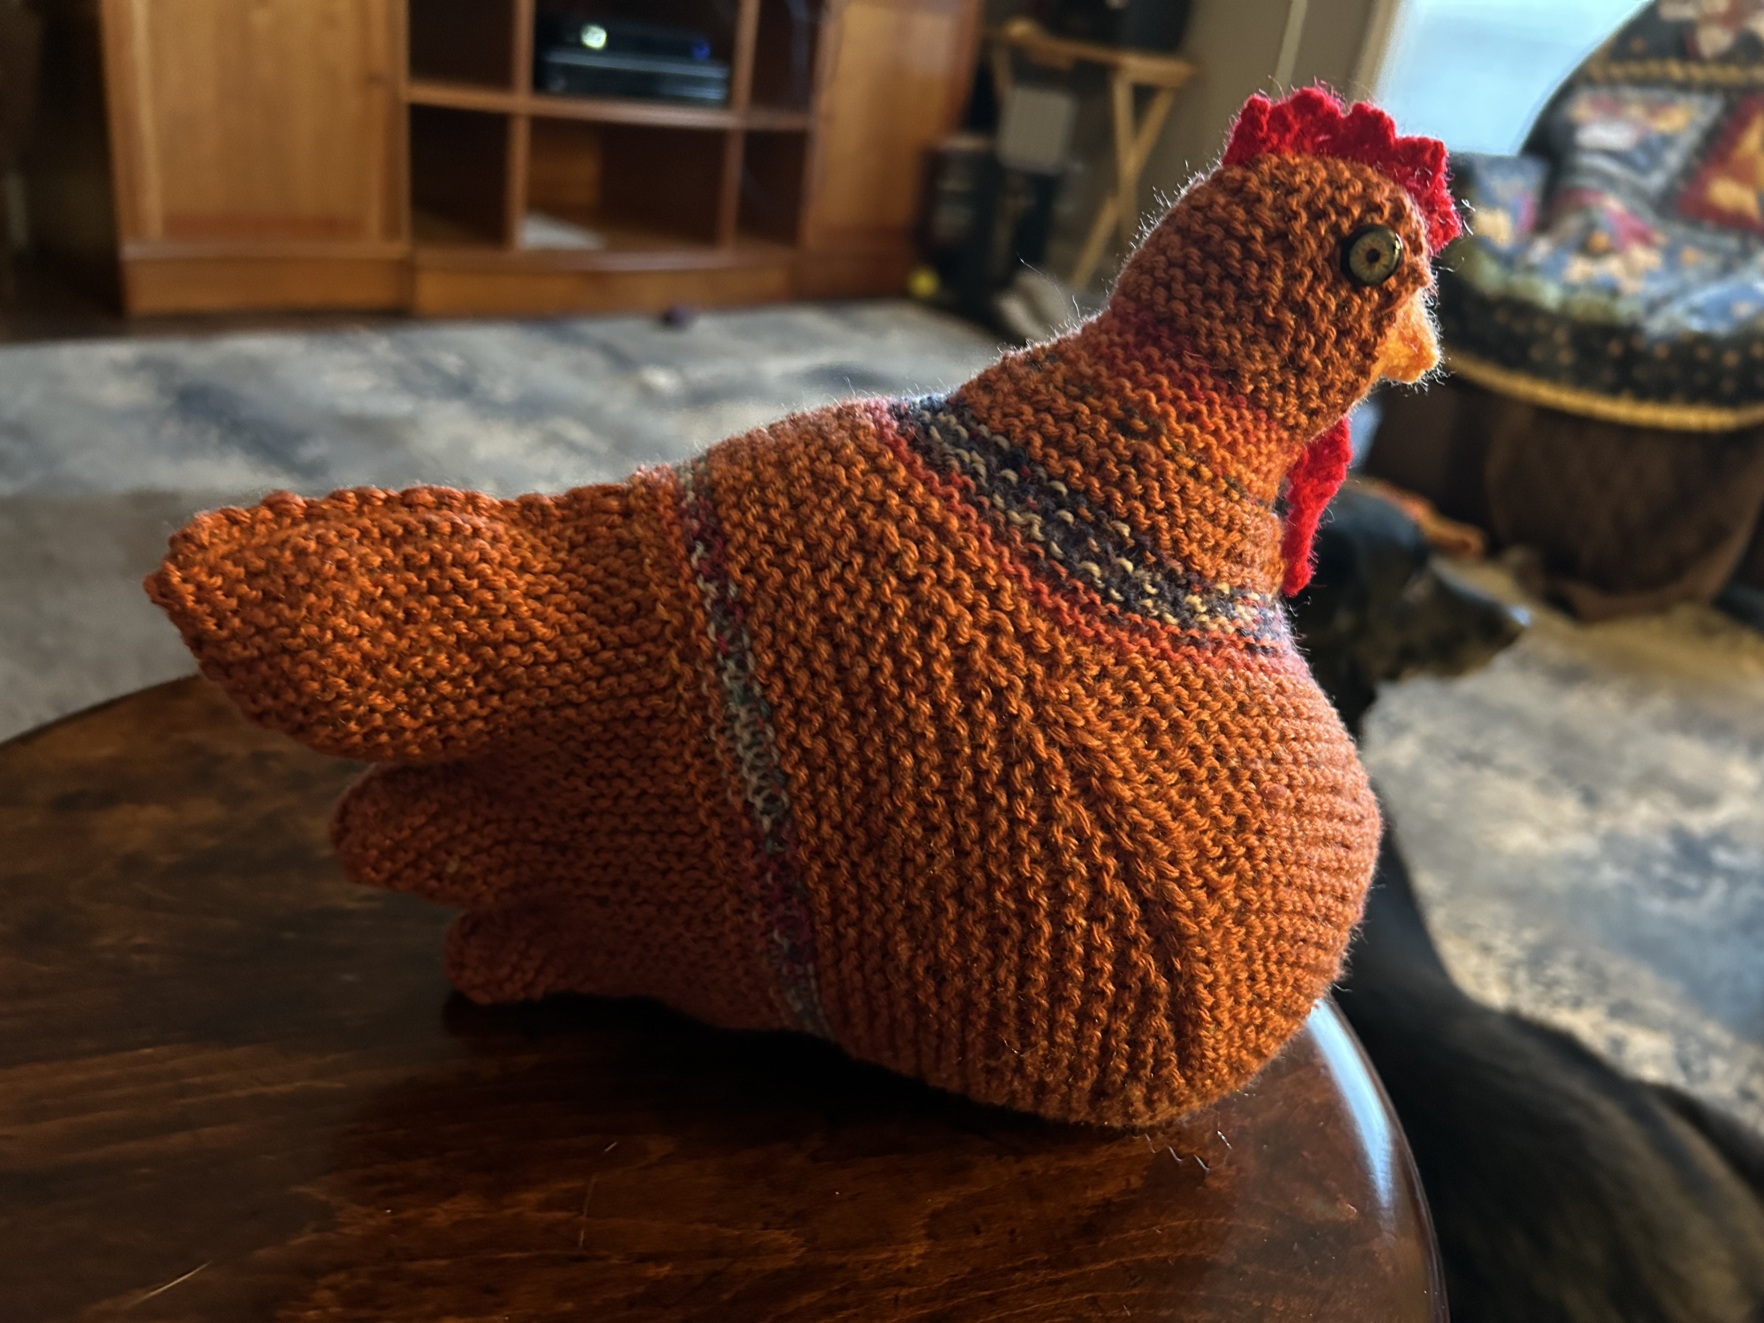
Sara

Slide 23
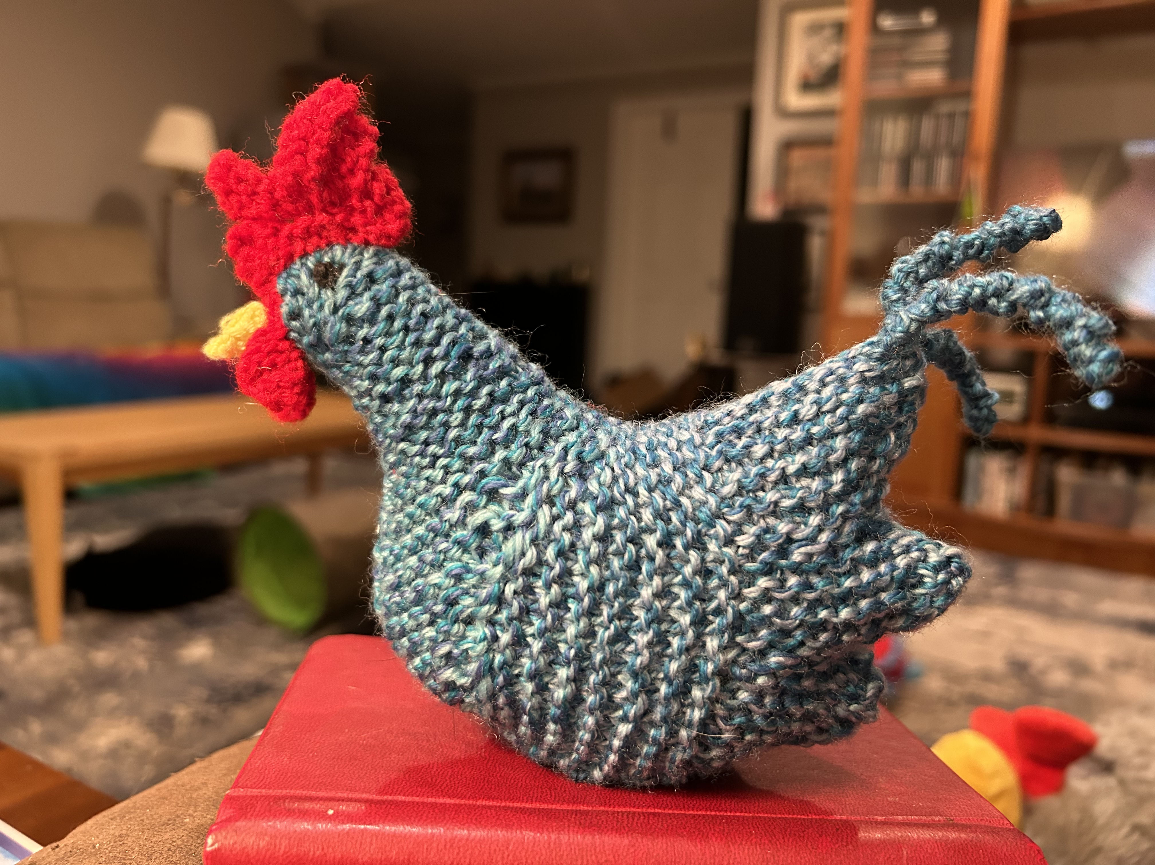
Sara

Slide 24
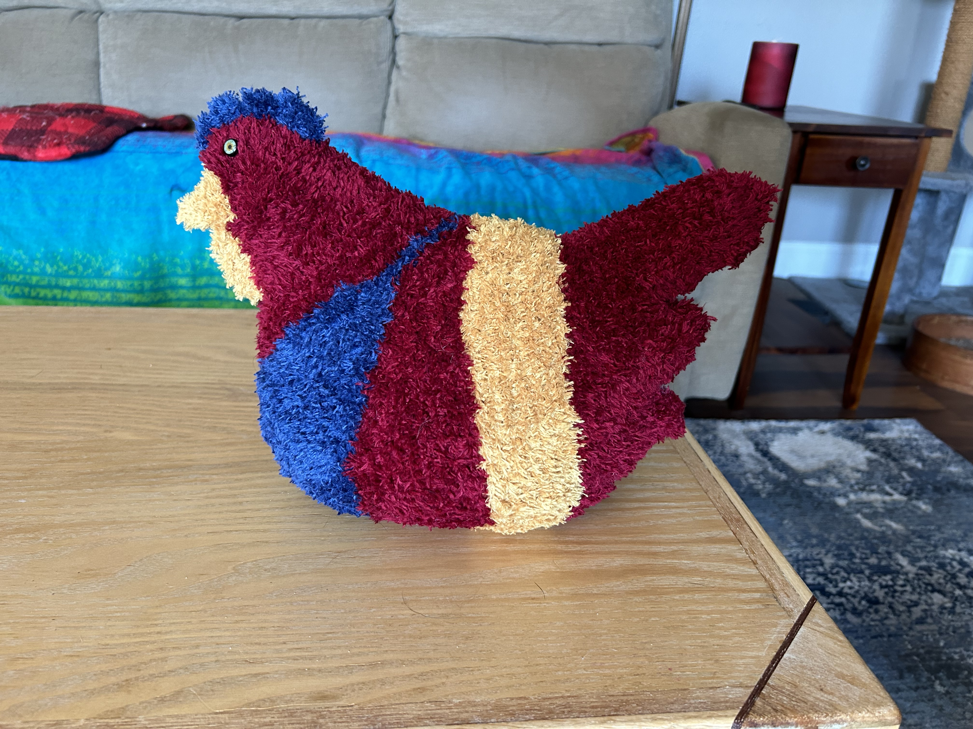
Sara

Slide 25
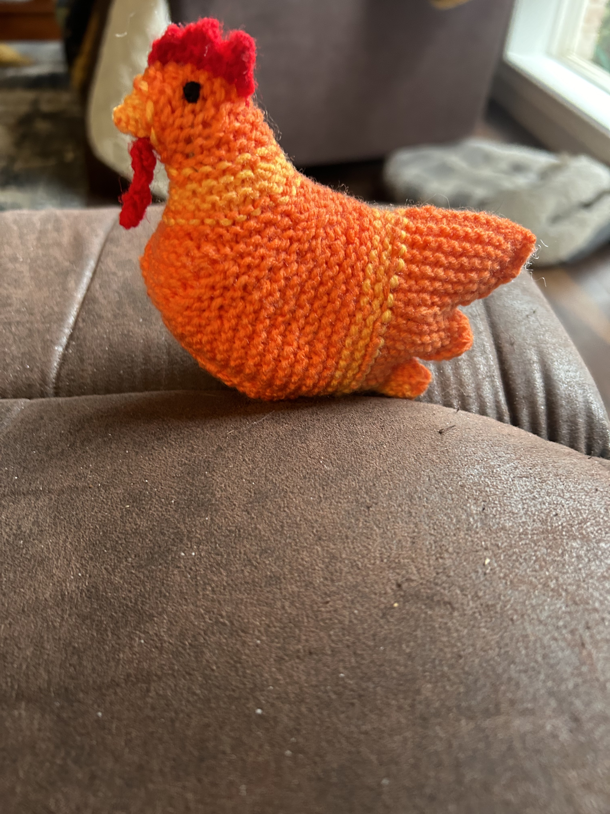
Sara

Slide 26
Karin

Slide 27
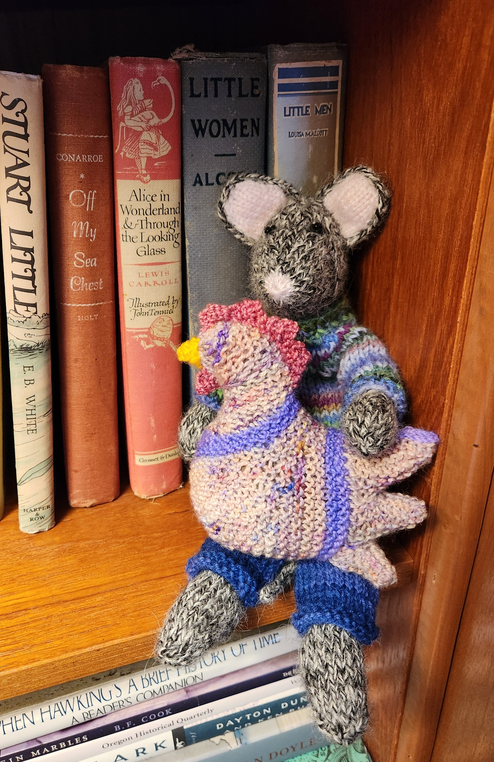
Karin

Slide 28
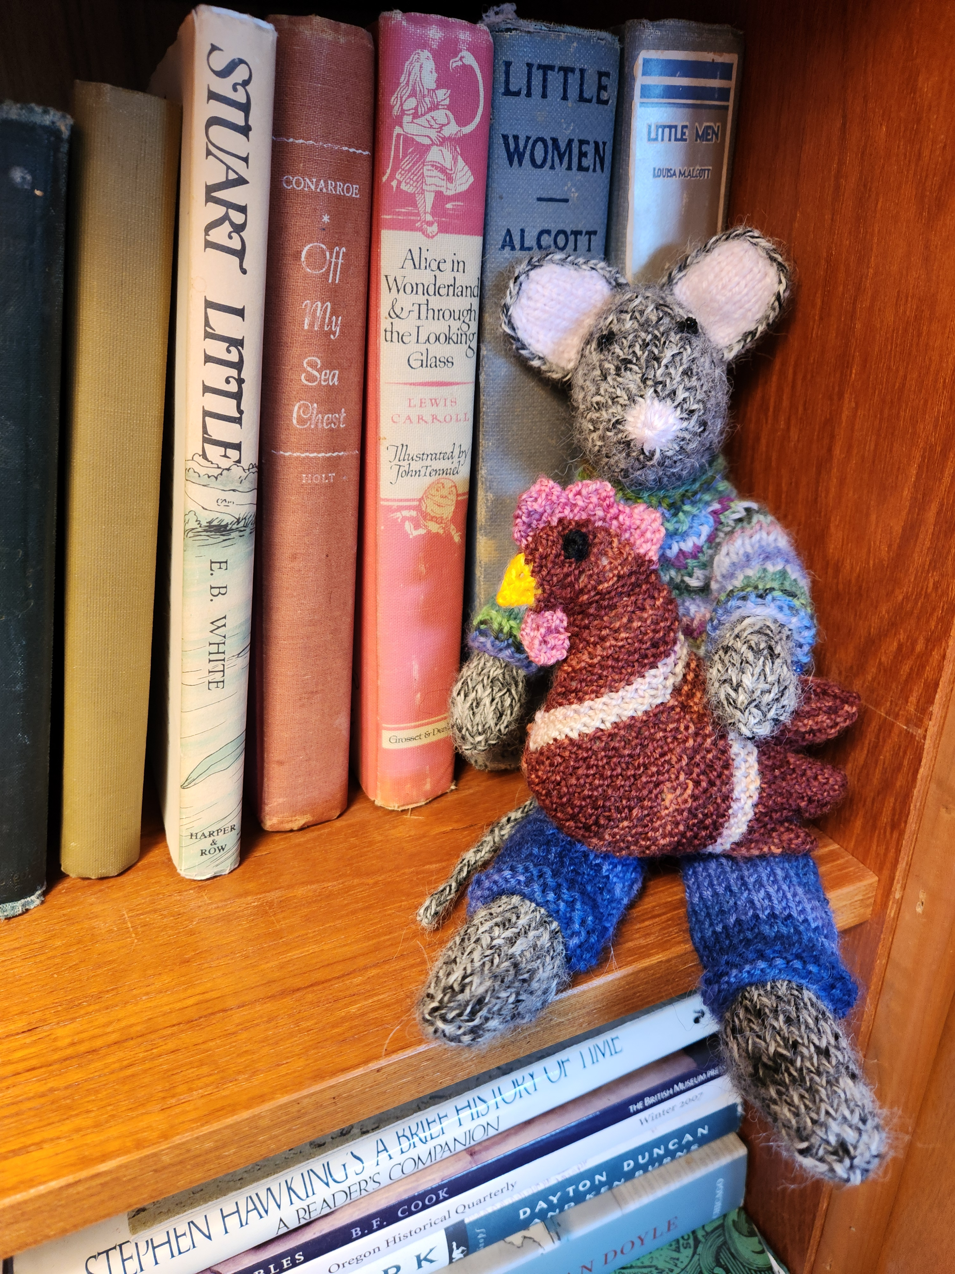
Karin

Slide 29
Now let’s meet the Emotional Support Chickens
who flew into our meeting today

